Slide 1

Smart Mobility Service
Midterm Assignment
Johanna Catharina 12200070
Gulzhan Isaeva 12194812

Slide 2
Project Goals
1. to create a service that the ROS service client node will send the GPS location of the autonomous car and then the ROS service server will send back the current weather status (in Celsius degrees °C)
2. to create a publisher that the ROS publisher node will send the speed of the autonomous vehicle and then the ROS subscriber node will echo the plate number of the vehicle if it exceeds the speed limit
3. to set the speed limit parameter in Kilometers per hour (km/h)
4. to create a launch file that enables automatic running of the subscriber and publisher nodes

Slide 3

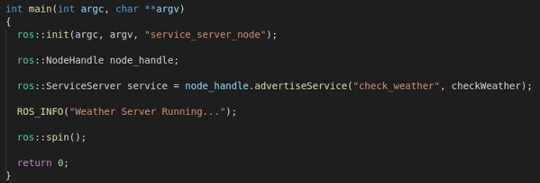
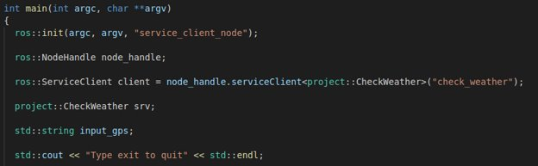
Task 1
Service Client Main code
Service Server Main Code

Slide 4
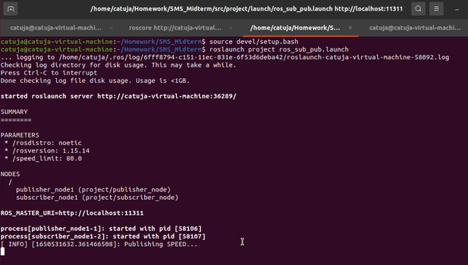
Running client/server

Slide 5
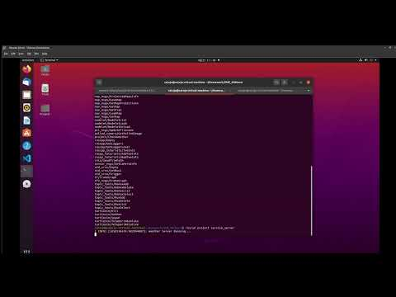
Demo functionality video 1

Slide 6
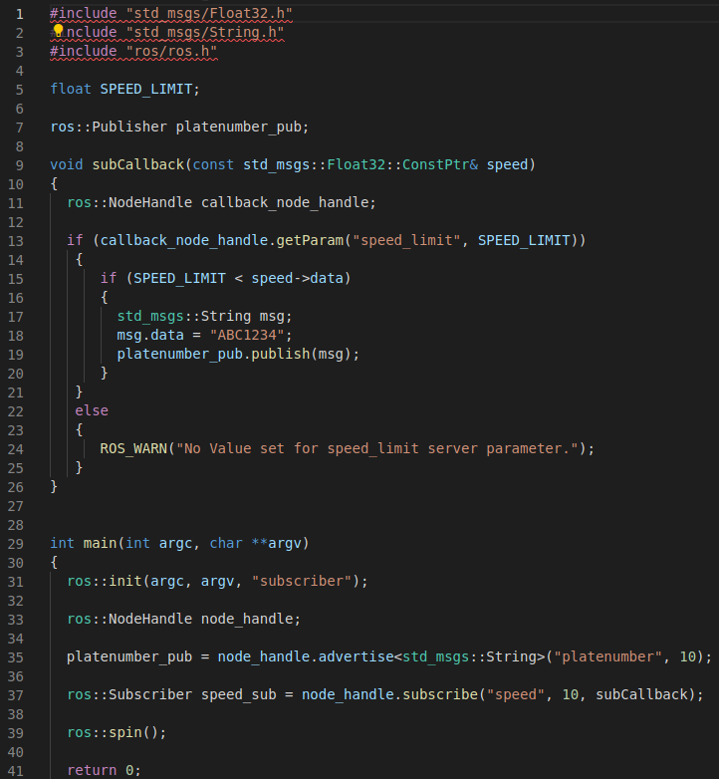
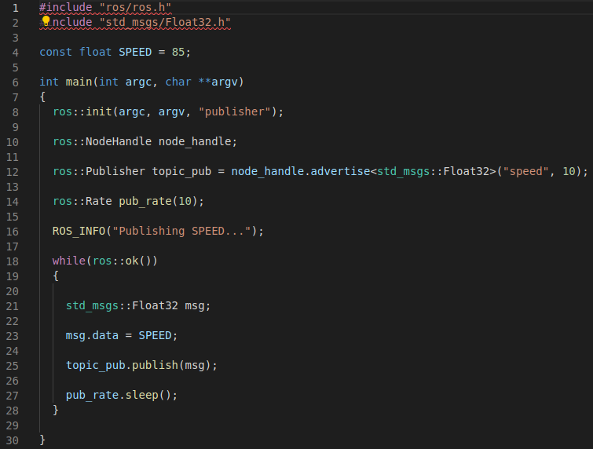
Task 2
Publisher Node
Subscriber Node

Slide 7
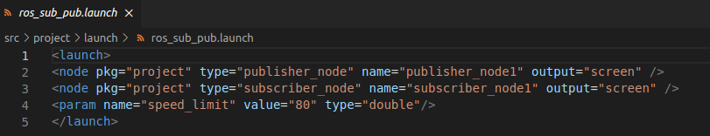
Launch file

Slide 8
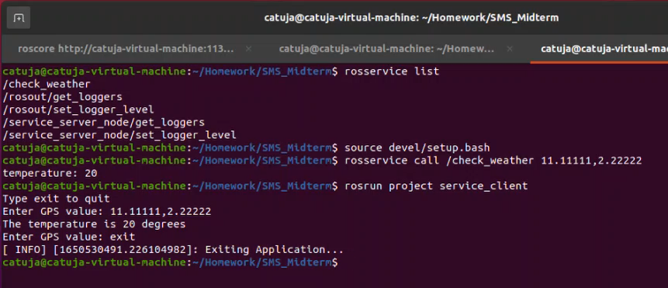
Running publisher/subscriber

Slide 9
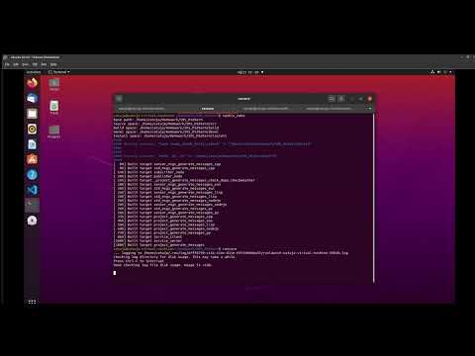
Demo functionality video 2

Slide 10

Thank you!
Q&A

